Slide 1

Tennessee General Assembly
Legislative
Internship Program
Jumpstart your
professional
career here!

Slide 2
About the Legislative Internship Program
The Tennessee Legislative Internship Program was established by the General Assembly in 1972 and has a longstanding reputation of providing students the best opportunity to learn more about the legislative process.
Each year, students from across the state are selected to spend their spring semester in Nashville to serve alongside the members and staff of the General Assembly during the legislative session.

Slide 3
About the internship
Assist in researching legislation and in-depth analysis of legislative issues
Communicate with state, local, and federal government agencies
Interact with constituents from across the state
Develop talking points and legislation summaries
Learn and understand the legislative and committee process
Understand the role of lobbying as it relates to the legislative process
Attend legislative sessions and committee meetings
Work with a Legislator as a part of their team

Slide 4
Who is Eligible?
Juniors, Seniors, and Graduate level students enrolled in a private or public Tennessee college or university
20 years of age by the start of the program
GPA of 3.0 or above
All majors are encouraged to apply

Slide 5
Internship Details
Full-time and Part-time internships available during the spring semester only
Weekly stipend of $500 (full-time)
$13.33 per hour (part-time) with a minimum of 20 hours per week
Earn up to 12 hours of college credit
Opportunities to cultivate relationships and network
Must attend weekly meetings
Interns will be responsible for their own housing
Opportunity to participate in Mock General Assembly
Hold elections for Mock General Assembly leadership team

Slide 6
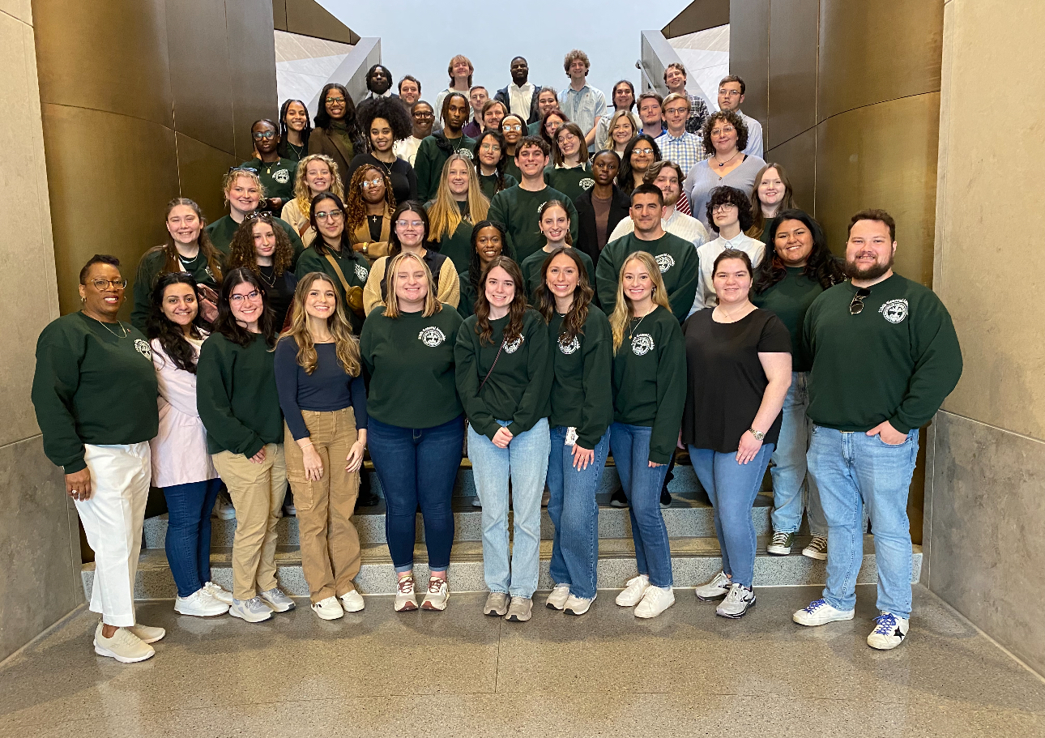

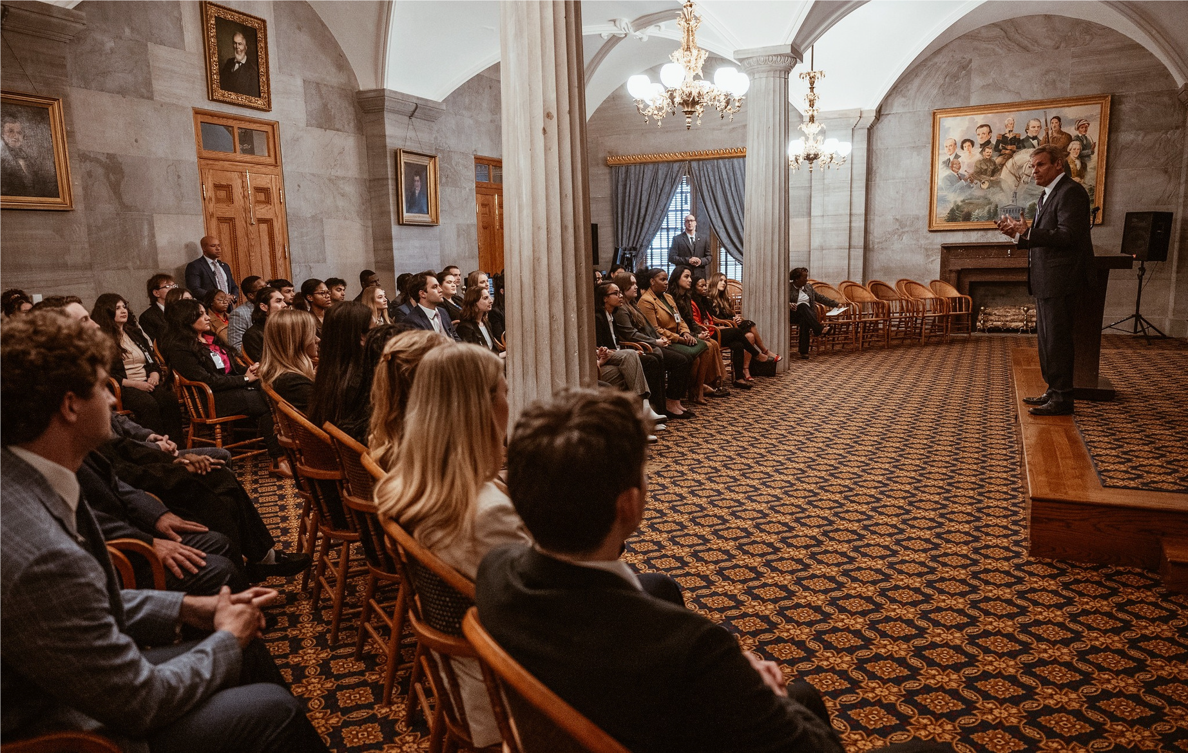
Why should I apply?
Join the class on excursions to the Tennessee State Museum, Ellington Agricultural Center, and the TBI Headquarters as well as other educational and fun activities
Meet the Governor, Constitutional Officers, and other top leaders in
Tennessee State Government
Participate in community service projects that directly benefits the community

Slide 7
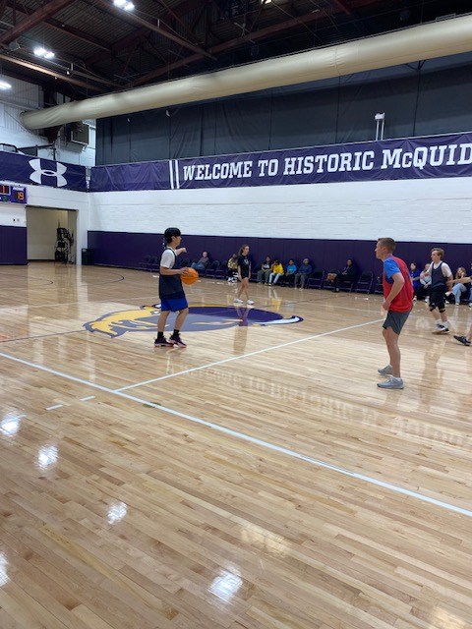

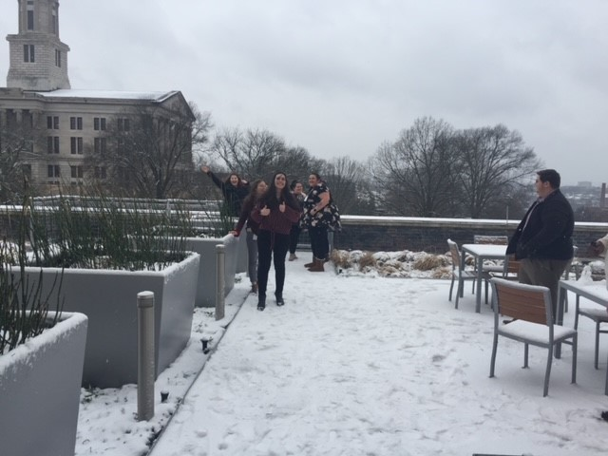
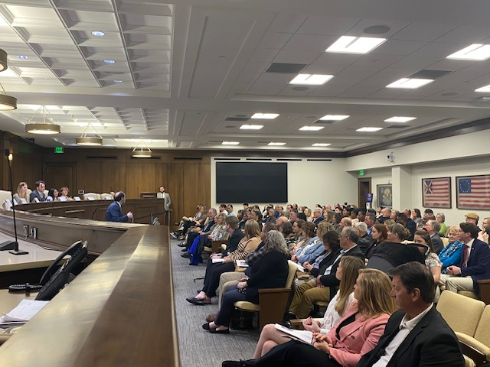

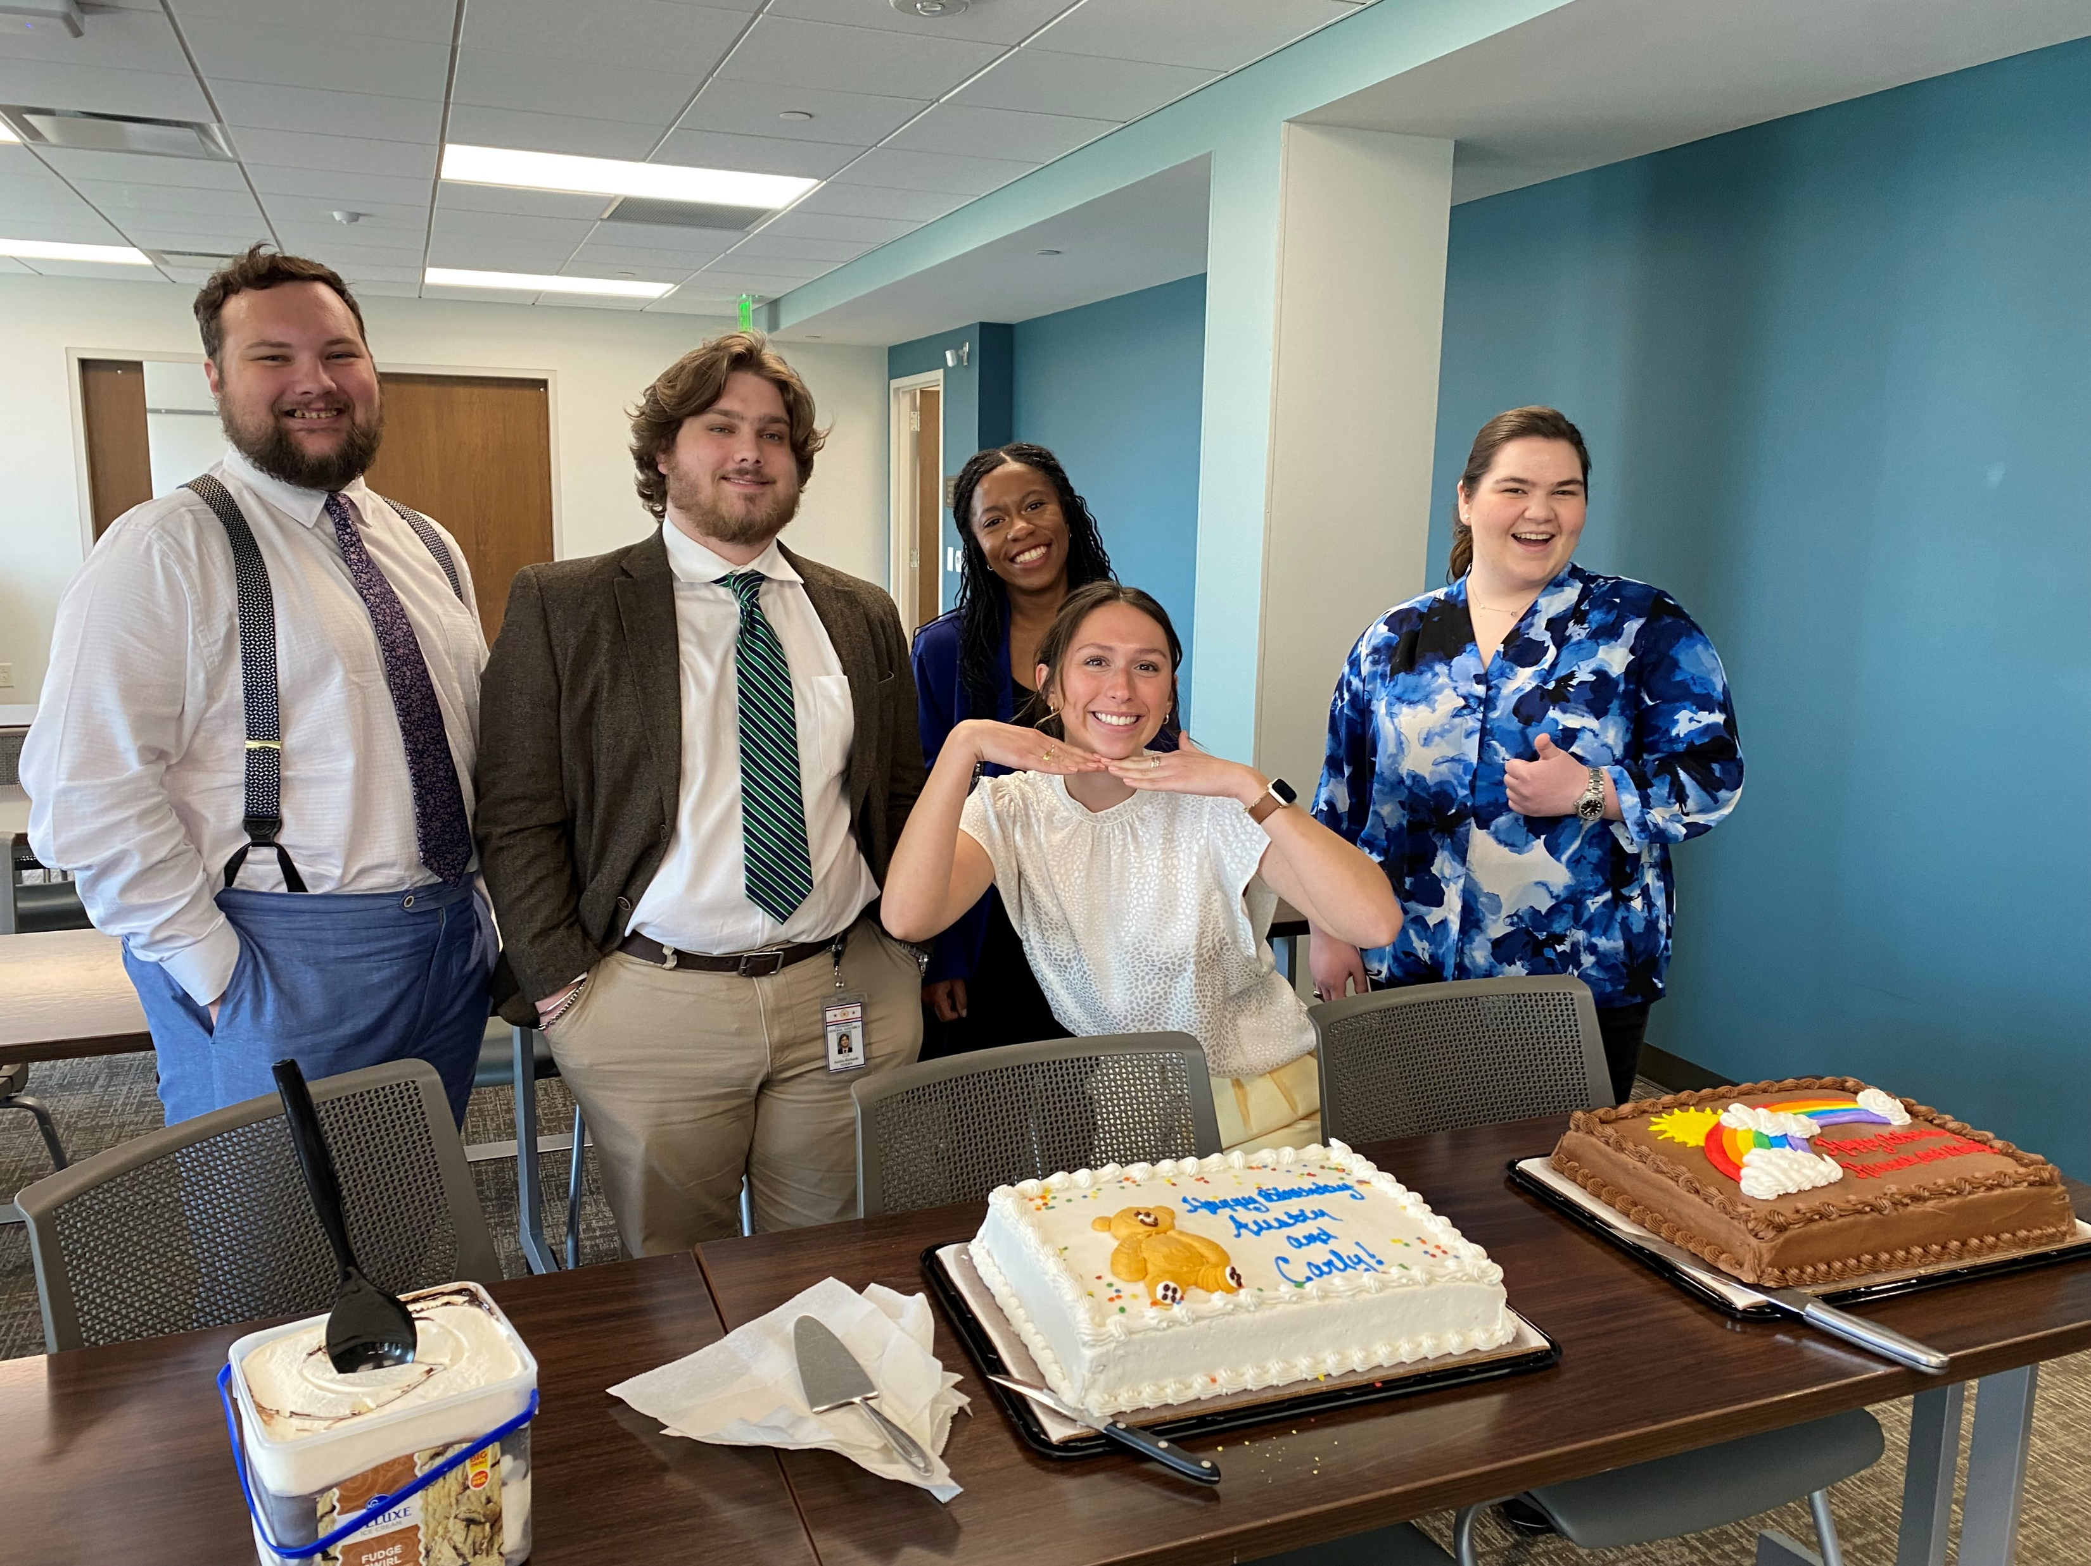
Some fun activities
Member vs. Intern
Basketball Game
Trevecca Center for Rehabilitation and Healing
Snow Day in Cordell Hull
Family Day
50th Anniversary Celebration
Birthday Celebrations

Slide 8
Uniform Policies Governing the conduct of legislative interns
All interns are required to attend the pre-session orientation sponsored by the Legislative Internship Program Director.
Interns are required to keep regular state business hours (Monday – Friday, 08:00 – 4:30) during the term of their appointments. As legislative employees, interns are further advised that there may be occasions when they will need to work overtime to complete their work assignments, so they should plan to adjust their schedules accordingly.
Interns are allowed one hour for lunch and should be coordinated with the office staff.
Interns should follow a dress code of standard office dress including for female employees a professional dress, skirt and blouse, suit, dress slacks, or another professional ensemble. In the case of male employees, suit or dress trousers and jacket, together with appropriate accessories (tie).
Interns should report for work every day and work a full day regardless of whether the member or staff is in the office or not. If extreme circumstances necessitate an interns’ absence or tardiness, the intern should advise their assigned office, as well as the legislative internship program director before 8:00 a.m.

Slide 9
Uniform Policies Continued
Interns should keep any information that they acquire in the strictest confidence, and should be advised to ask the staff in their assigned office about any information before relating it to anyone. What goes on in the assigned office should remain in the office. Do not repeat or share information with other interns, staff, or anyone else outside of the assigned office.
Interns SHALL NOT attend receptions or other functions held for the General Assembly after hours or outside of the Cordell Hull building. NO EXCEPTIONS.
During the term of the internship, interns are prohibited from actively participating in partisan political activities during work hours. Interns are also prohibited from advocating for or against legislation that is pending in the General Assembly if it is outside the scope of the intern’s assigned duties. Interns should refrain from posting items on social media that may have the effect of creating a disruption in the workplace or cause the appearance that you are no longer impartial in the performance of your duties. Bearing in mind, interns are representatives of the legislature, their respective university or college, and the internship program.
All interns should avoid any conduct or activities that would cause embarrassment or which might ethically, legally, or morally compromise them, their sponsoring institution, or the General Assembly. INTERNS UNDERSTAND THAT THE LEGAL AGE IN TENNESSEE FOR THE CONSUMPTION OF ALCOHOLIC BEVERAGES IS TWENTY-ONE (21) YEARS OF AGE.

Slide 10
Uniform Policies Continued
Interns should remember to behave in a courteous manner with any person they may come in contact with in performing their duties. Interns should keep in mind that they reflect the Tennessee General Assembly and the Legislative Internship Program.
Interns are not permitted or authorized to solicit or accept contributions or donations from legislators, lobbyists, or permanent staff for any purpose. This is a violation of the ethics laws in Tennessee.
Interns are not permitted to lobby for or against legislation during the term of their internship.
Interns should use office equipment for legislative business only. Use of telephones, fax machines, copiers, or any other office equipment, for personal or political business is strictly prohibited.
Interns should recognize that most legislators have only one or two staff members and that interns are expected to share routine office work (filing, photocopying, answering the telephone, running errands, posting notices, etc.) with the full-time staff, if necessary, to expedite the work of a legislator, a committee, or a legislative office.
Interns should also recognize that the limited size of the legislative staff requires that all legislative employees be expected to demonstrate initiative and cooperation with each other to meet the demands of a given legislative office.

Slide 11
Uniform Policies Continued
Interns are advised that parking spaces are critical during the legislative session and strict compliance with all parking regulations is required of all legislative interns.
Interns are reminded that rules of the House and Senate Chambers prohibit legislative employees, including interns, from entering the chambers during floor sessions without prior authorization from the Chief Clerk.
Interns will be furnished identification badges, which they will be expected to wear at all times while they are at work for the General Assembly.
Due to the nature, demands, and duration of the legislative internship program, no intern assigned to any office within the House of Representatives or the Senate shall seek any Federal, State, County, Municipal, or political party executive committee office. Any action contrary to this policy shall result in dismissal of the intern from the legislative internship program.
Any intern found to have violated the policies outlined above shall be subject to disciplinary action appropriate for the offense to be administered by the Legislative Internship Program Director, which could result in dismissal from the program.

Slide 12
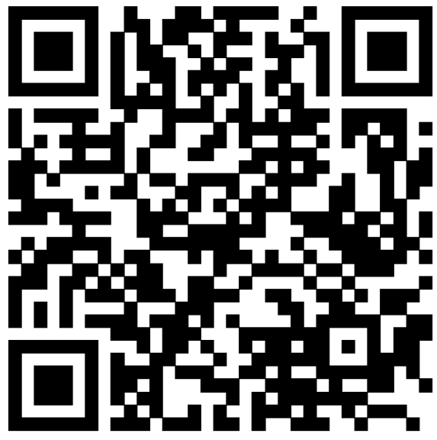
How do I apply?
Interested students should contact the official faculty representative at their respective college or university for more details. A list of faculty representatives and information about the program is available at www.capitol.tn.gov/intern

Slide 13
Important dates
Application Deadline: October 16, 2025
Interviews: October 28, 29, and 30 2025
Offer Letters Sent: Week of November 3, 2025
Meet & Greet for Selected Students: December 4, 2025 (subject to change)
Start Date: January 12, 2026
Last Day: May 1, 2026

Slide 14

Questions?
Shirley A. Frierson, Director
Legislative Internship Program
425 Rep. John Lewis Way North,
Suite G-124
Nashville, TN 37243
Office: 615-741-3299
Cell: 615-945-4736
shirley.frierson@capitol.tn.gov
www.capitol.tn.gov/intern
J.R. Russell, Administrator
Legislative Internship Program
425 Rep. John Lewis Way North,
Suite G-124
Nashville, TN 37243
Office: 615-741-3299
Cell: 629-278-0418
j.r.russell@capitol.tn.gov
www.capitol.tn.gov/intern

